Slide 1
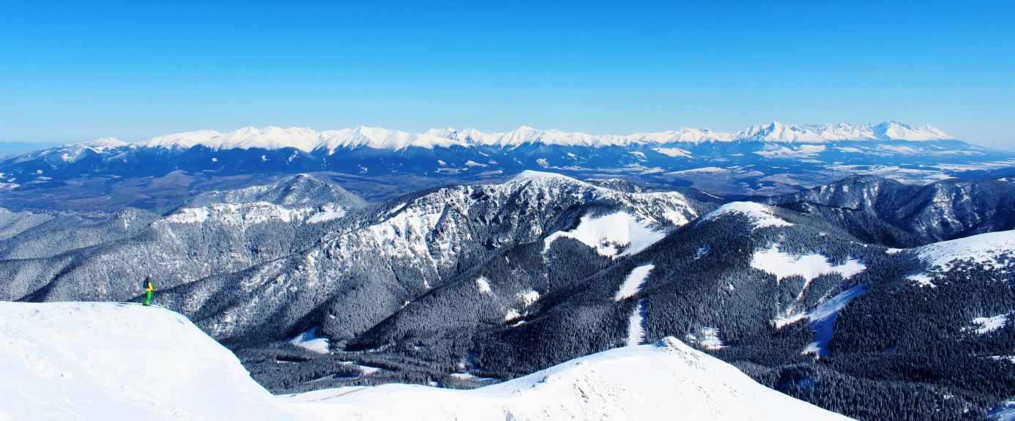
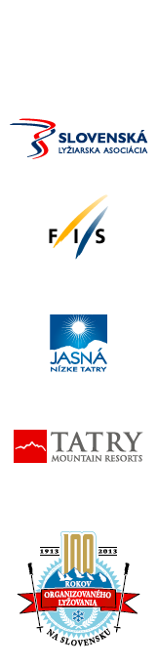


FIS alpine World Cup in CZE and SVK
2016 and following up
Špindlerův Mlýn & Jasná Nízke Tatry

Slide 2
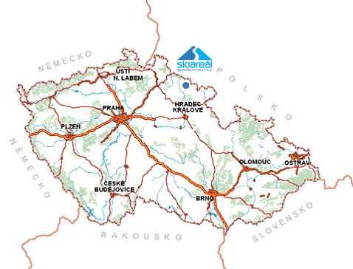
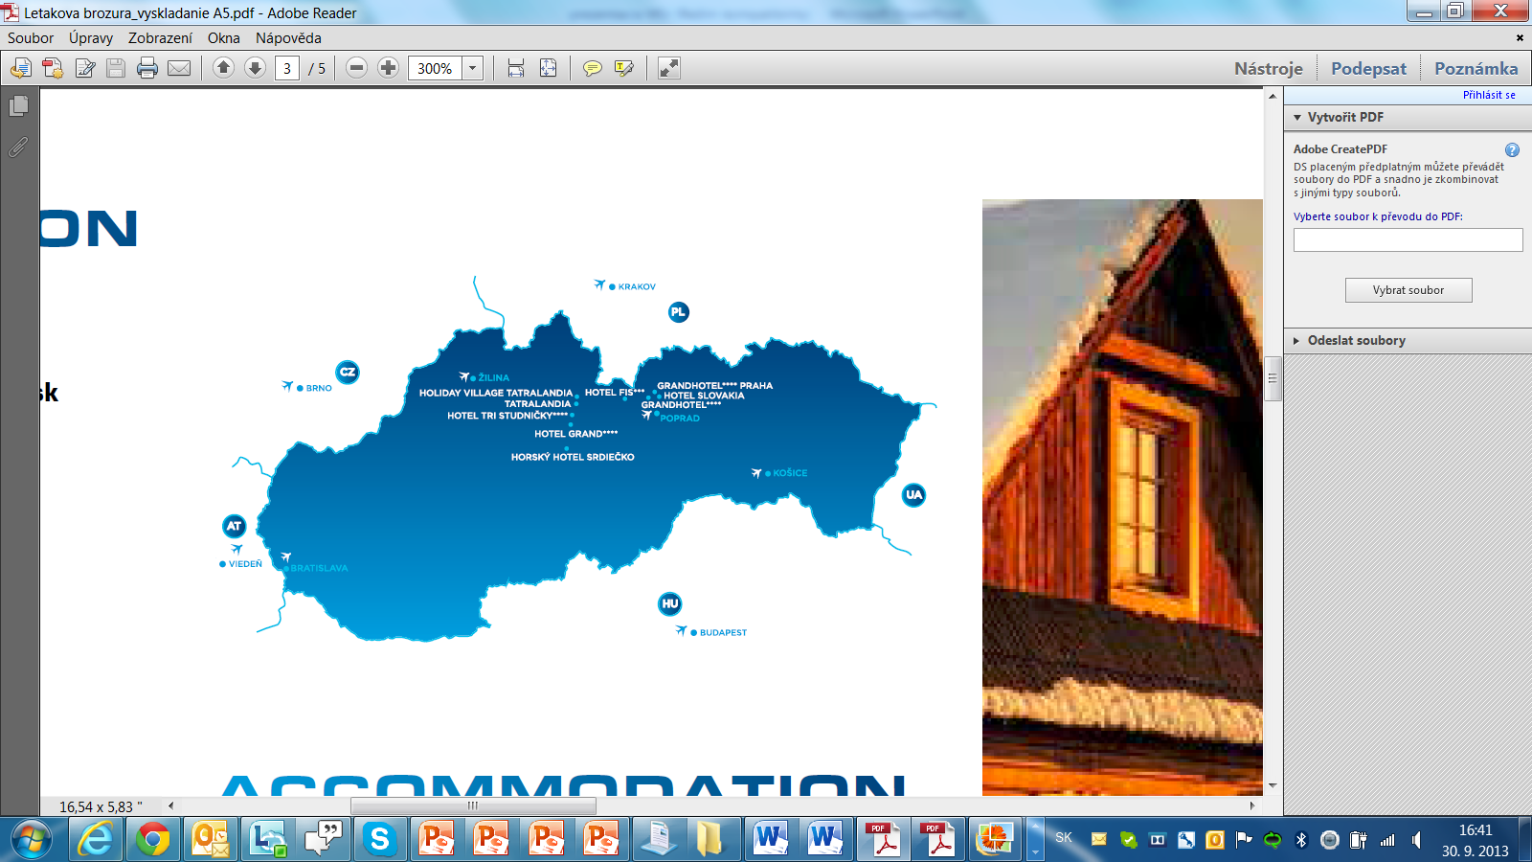

FIS alpine World Cup in CZE and SVK
2016 and following up

Slide 3
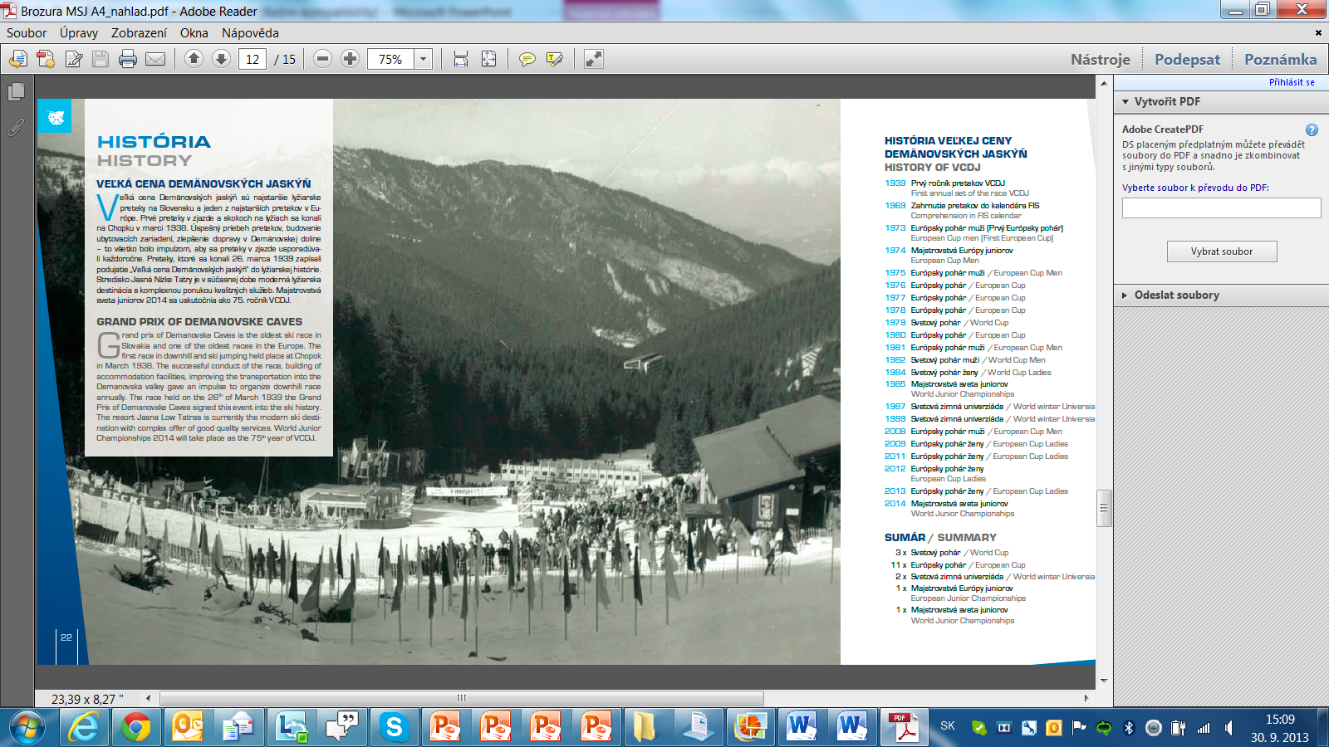
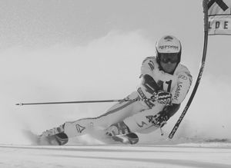
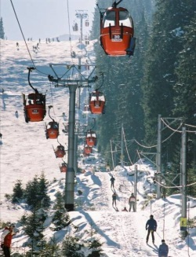
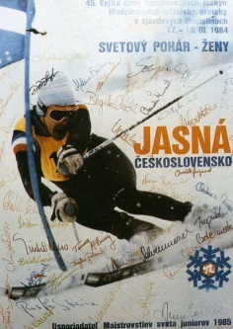
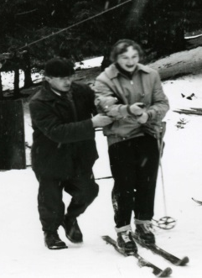
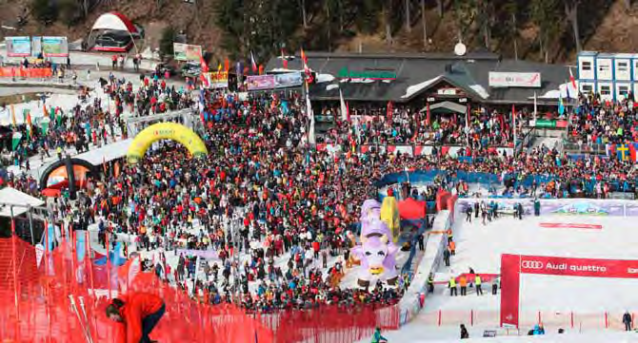
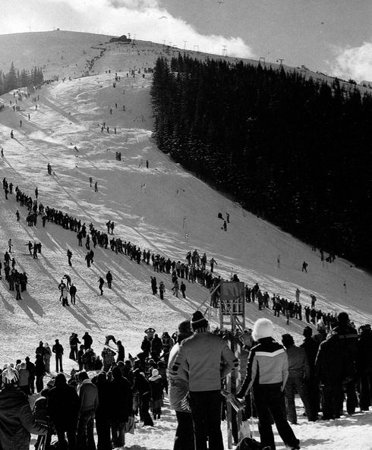

PROLOGUE
Czech and Slovak ski associations are long-time members of FIS with many achievements on both athletes and organizers side. 110 years in Czech Republic and 100 years in Slovakia of organizing skiing are evidence of developing, improving, promoting and passion that we bring to the ski sports. The popularity of skiing in our region is huge. And with the world class success of our athletes in the last decade it grows even more. To bring World cup in our region held on annual base is not our final goal. It should be the beginning of the new era with successful athletes and significant events.

Slide 4
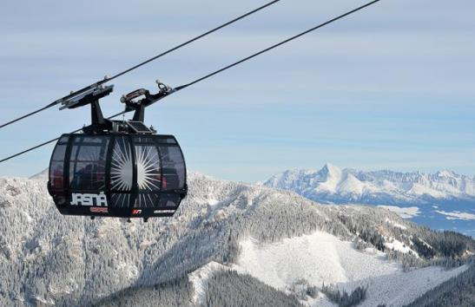
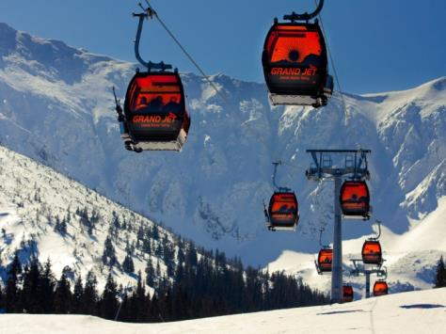
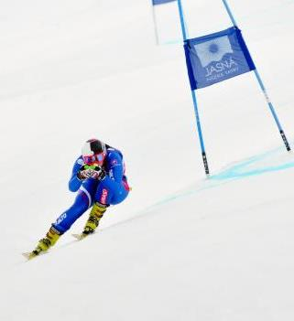
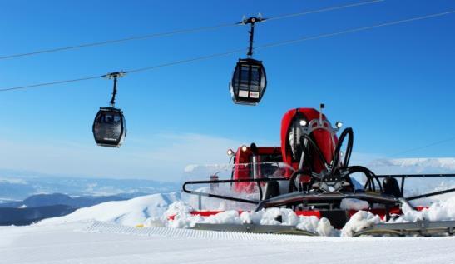
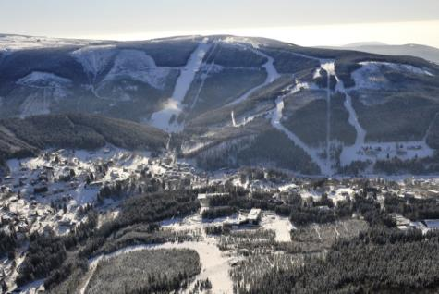
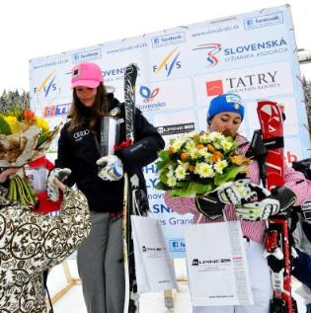
VENUES
Jasná (SVK) and Špindlerův Mlýn (CZE) are well known ski resorts with an international reach. Both of them organized top alpine events in far or near past. They are modern snow sports arenas with the best transport infrastructure and high transport capacity. Huge investments are spent every year to improve the standard of resorts and to become more competitive. Tatry Mountain Resorts invested more than 100 millions € during the last five years only in Jasná and with half a million visitors per year this resort has become the biggest center of winter sports in wide region.

Slide 5
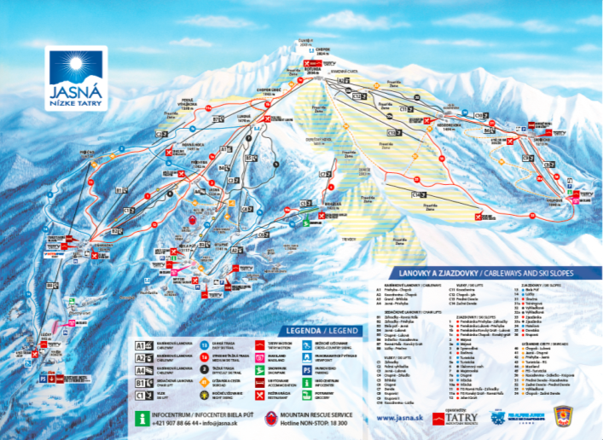
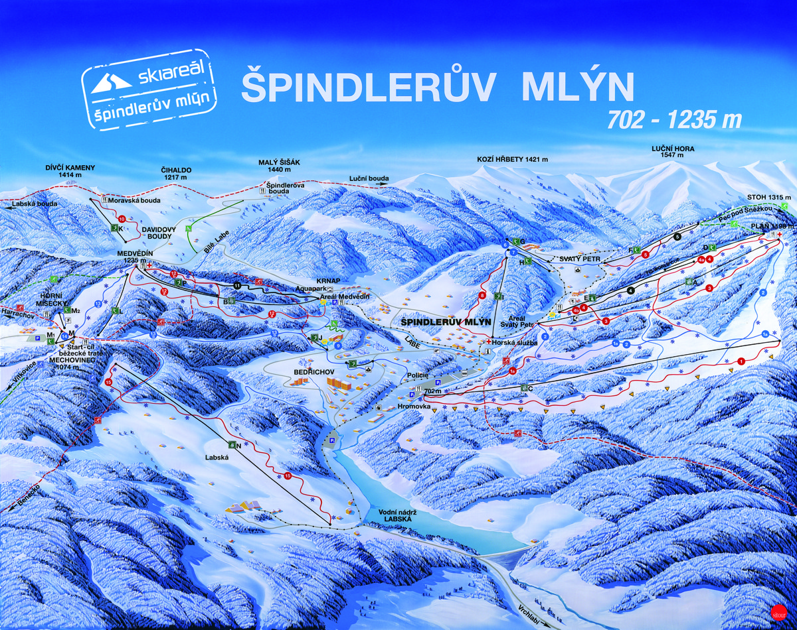

IDEA
Jasná and Špindlerův Mlýn are operating by the same company Tatry Mountain Resorts, which has become the biggest company operating in tourism in the wide region.

Slide 6
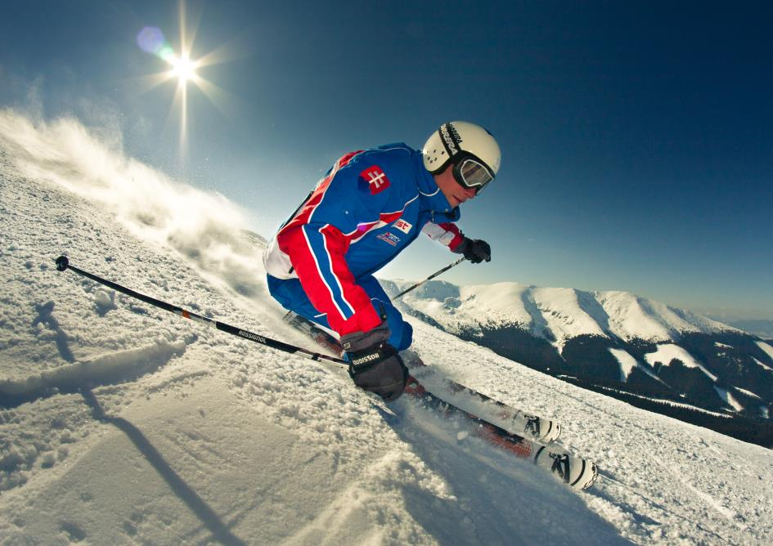

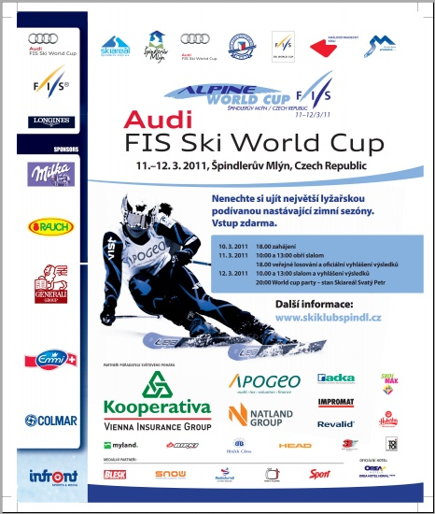
IDEA
This gives the Czech and Slovak OCs the opportunity to cooperate more effective and share experience and human resources. The idea of alternate on 2 or 3 years base is very good solution for us. It is easier to cover the budgets and find sponsors, but we still will be in touch with World Cup. Yet now we are sharing HR for big events, like World Cups in Spindler Mill (2005, 2008 and 2011) and it will be so during the WJC 2014 in Jasna as well.

Slide 7
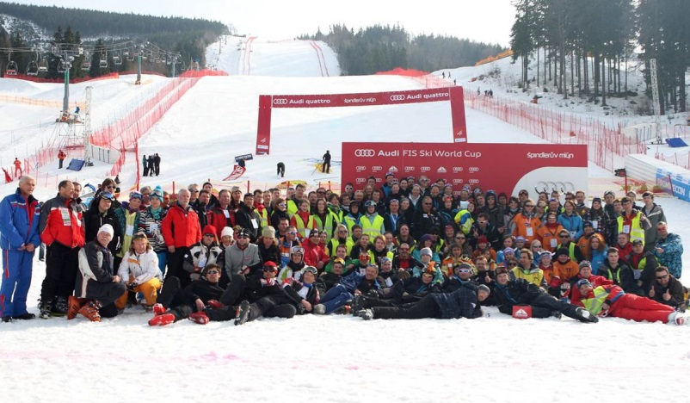
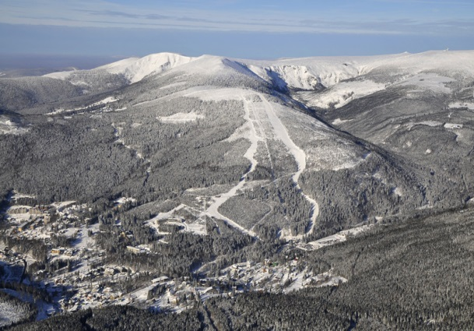
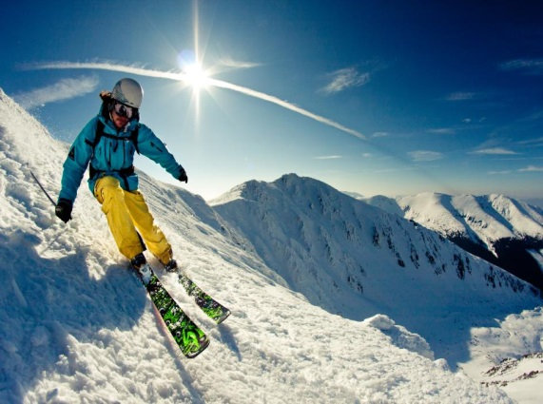
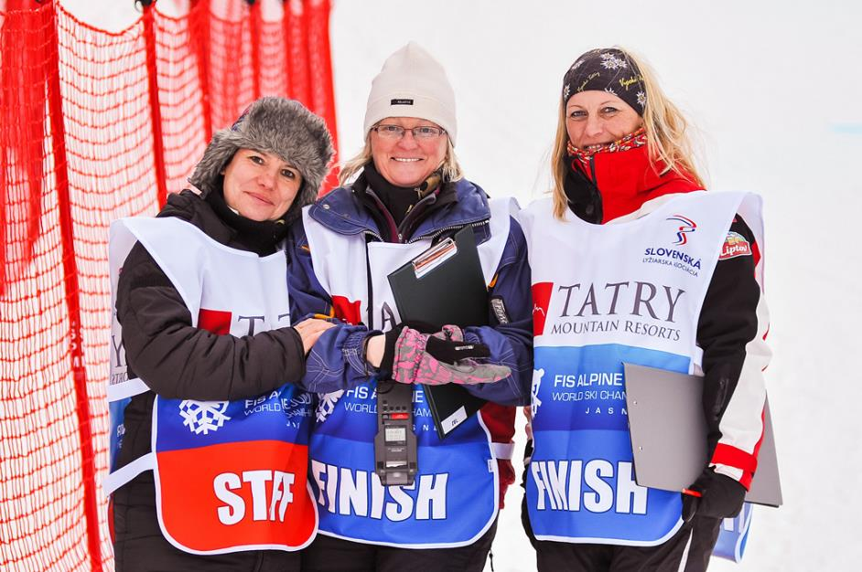
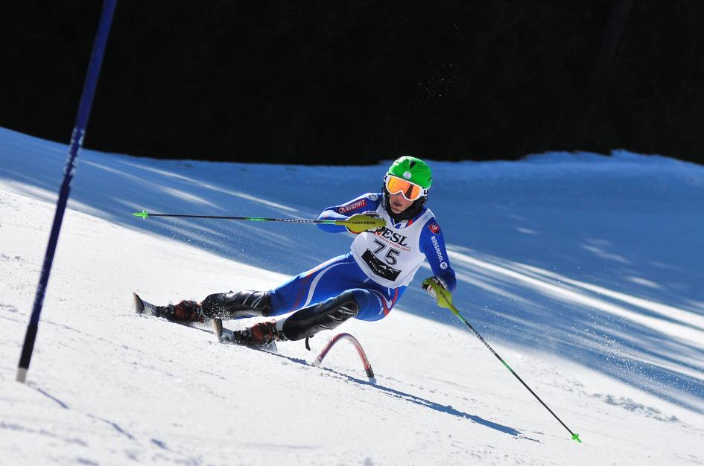
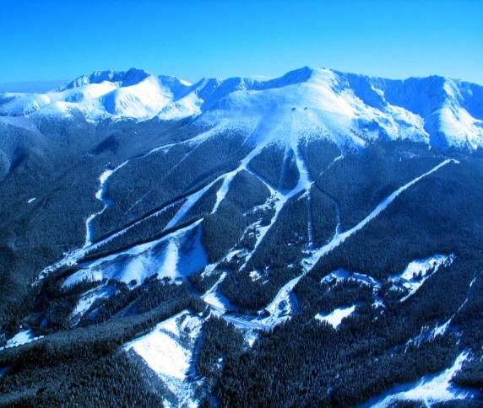
REALIZATION AND KNOW HOW
The OCs in both resorts are experienced and they are trying to learn their people continuously. Therefore for example staff from Jasná is attending in Snow Queen Trophy in Zagreb each year (from 2009) as a part of the course crew. On the other side, Špindlerův Mlýn OC has experience from 3 World Cups in last 7 years. During these World Cup competitions in Czech Republic and several European Cups in Slovakia the OCs proved their abilities to prepare perfect race courses even in late winter periods.

Slide 8
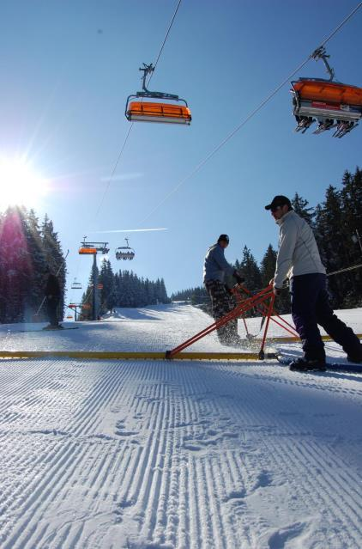
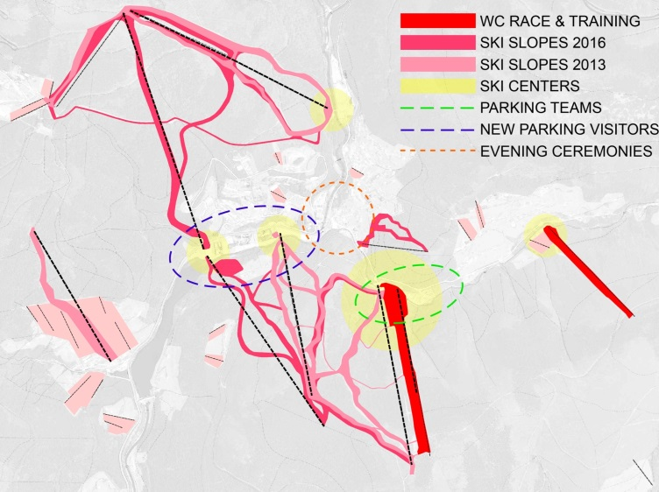
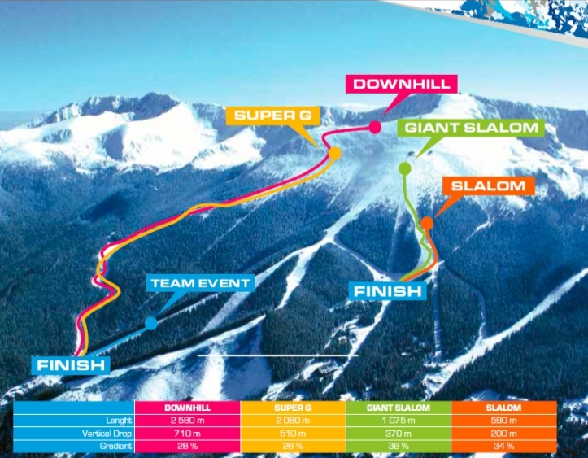
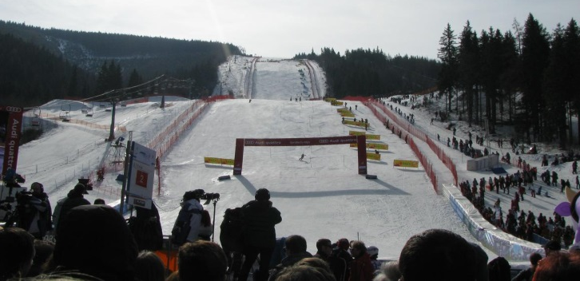
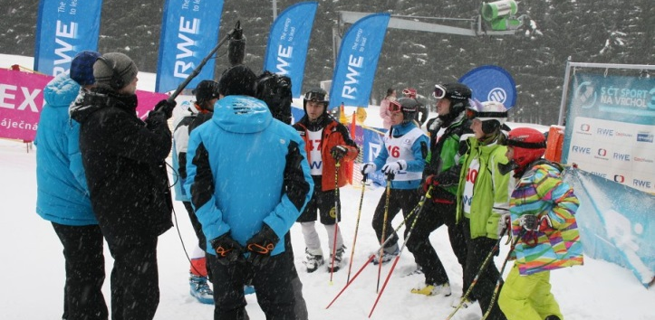
REALIZATION AND KNOW HOW
We suggest organizing World Cup events alternating every 2nd or 3rd year. We would prefer to start in Jasná 2016, then go continuously with Špindlerův Mlýn and then to swich between this resort, or to join one more resort (country) from eastern Europe.
Courses in Jasna and Spindler Mill are among the most challenging slopes for technical events in the wide region. With traditionally very good preparation this is hopeful earnest for quality races and conditions even in 2nd runs.

Slide 9
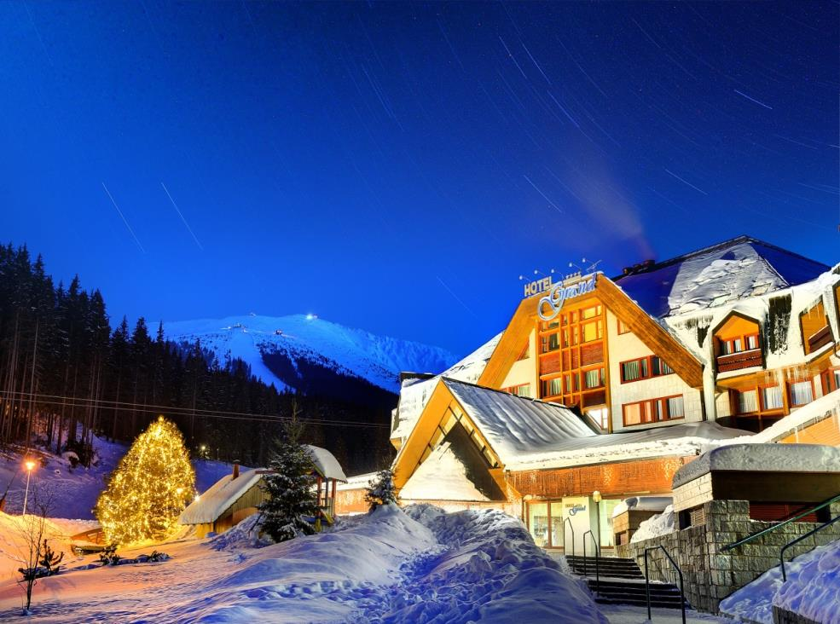
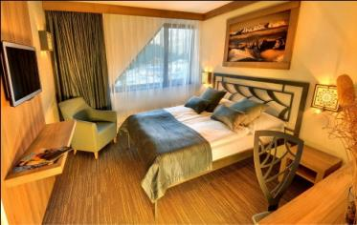
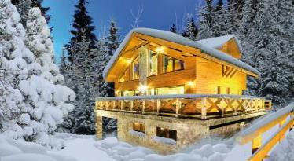
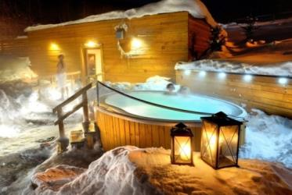
INFRASTRUCTURE & SERVICES
The sport infrastructure and services are growing year by year and this gives us a chance to build up a well equipped race area with high level background for athletes and teams. Accommodation facilities are on very high standard in Jasná and Špindlerův Mlýn and in sufficient capacities.

Slide 10
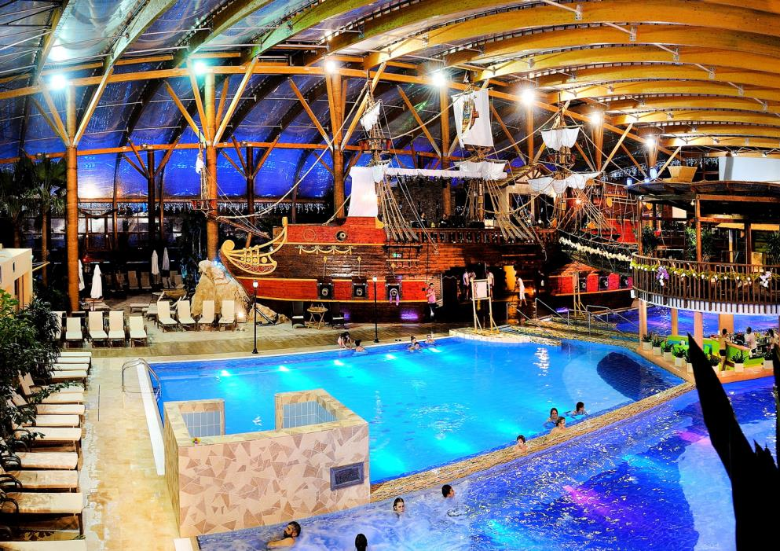
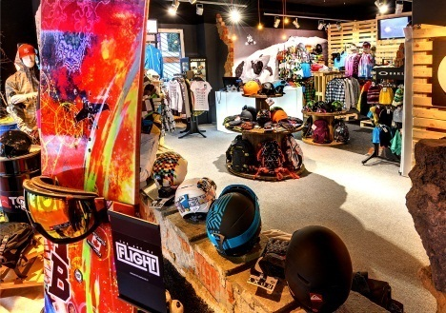
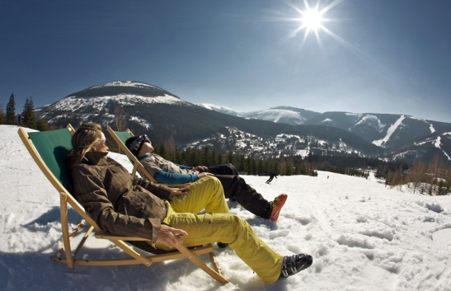
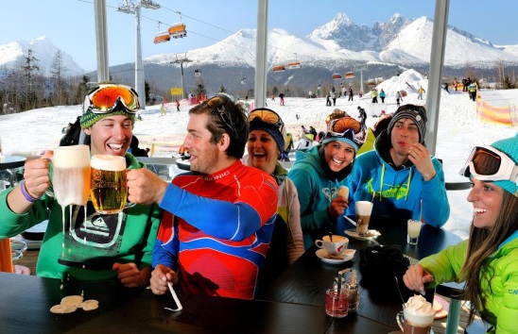
MORE THAN SKIING
The sport infrastructure and services are growing year by year and this gives us a chance to build up a well equipped race area with high level background for athletes and teams : Aquapark Tatralandia, Aqualand Moravia, excellent gourmet restaurants, night life, Tatrymotion (ski rental, service, ski school), fashion shops, wellness & spa and much more ...

Slide 11
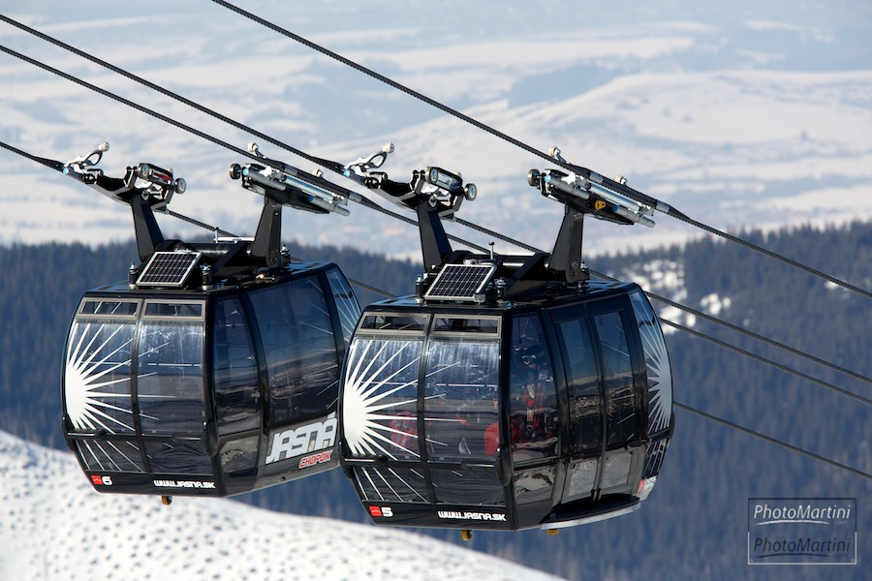
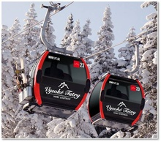
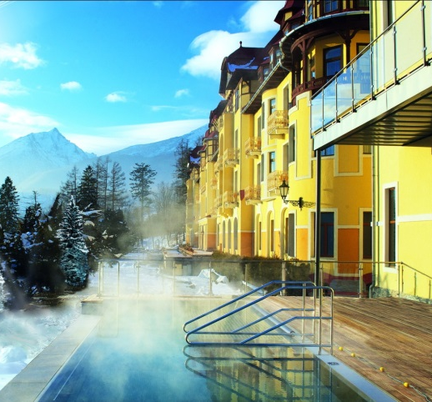
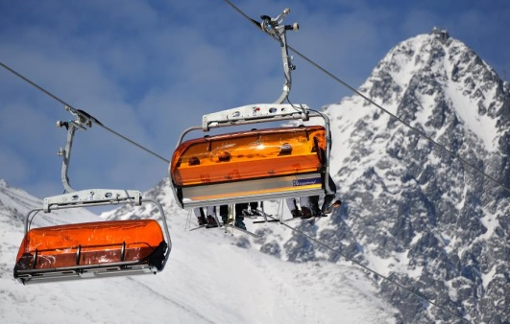
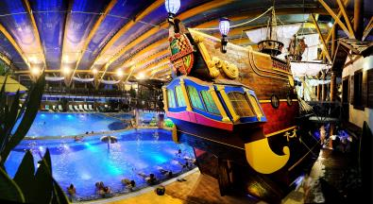
INVESTMENT 2008 -2013, 189 mil. EUR
JASNÁ NÍZKE TATRY & TATRY REGION
8 new cableways
New km of slopes and artifical snow making system of the new slopes
Enlargement and improvement of the slopes
2 new ski kindergarden with an area of 10.000m²
TATRY MOTION – 10 new facilities (rental, service, shop, kids areas)
Gastronomic facilities on the slopes – 33 restaurants and après-ski bars
SKI IN/ SKI-OUT transport – free ski buses system, new parking areas
Aquapark TATRALANDIA – new Tropical Paradise
11 top quality hotels & appartments – reconstruction and new rooms, high level wellness centres
Night Life – disco club Happy End and experience products

Slide 12
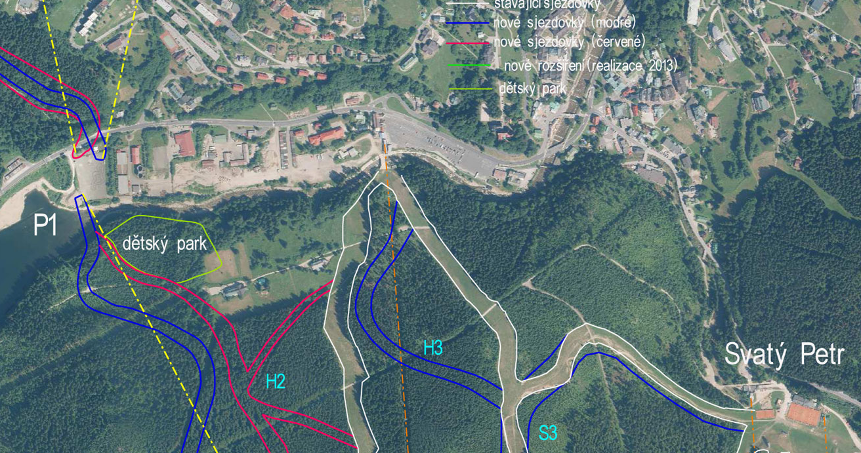
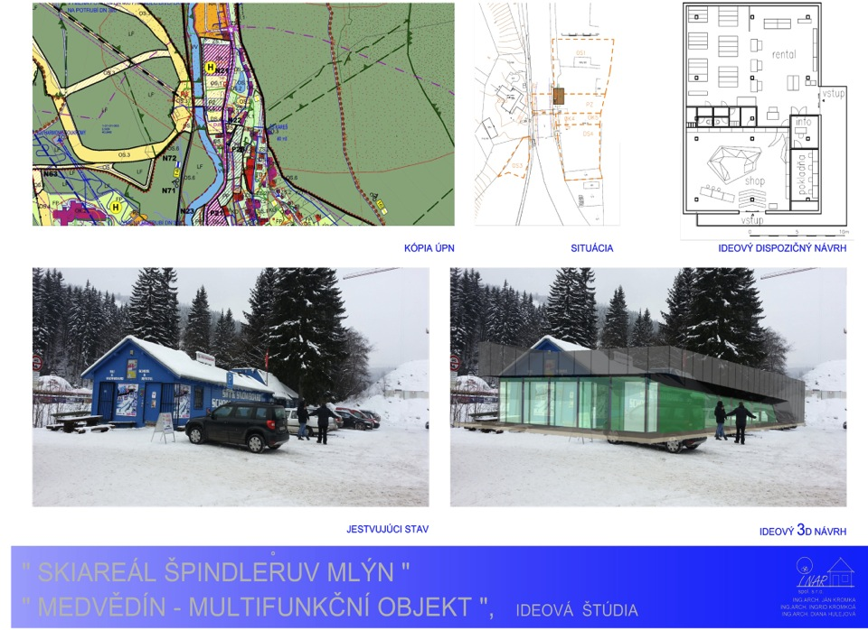
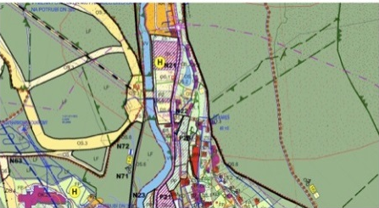
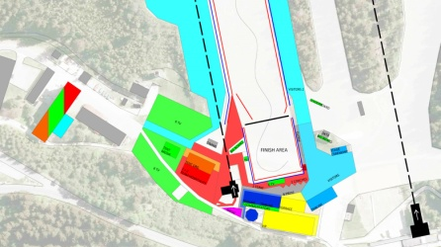
PLAN OF INVESTMENT 2013 -2016, 32 mil. EUR
ŠPINDLERŮV MLÝN
Interconnection of resorts Medvědín and St. Peter
4 new cableways
4 new slopes and 5 new ski routes
Enlargement and improvement of the slopes (red slope Medvědín – the widest slope in the Czech Republic)
2 new ski kindergarden with an area of 10.000m²
Complete artificial snow making system of the new slopes, installation of safety nets
SPINDL MOTION – 10 new facilieties (rental, service, shop)
Gastronomic facilities on the slopes – 20 new restaurants and après-ski bars
SKI-IN / SKI-OUT transport – free ski buses system, new parking areas

Slide 13
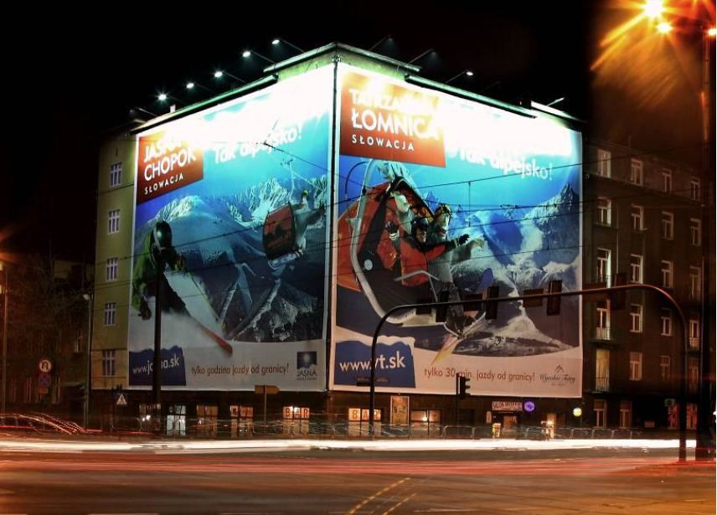


MARKETING – INTENSIVE GROWTH
Slovakia : strong marketing TV campain, bilboards, internet and PR
Poland : megaboards, bilboards, TV channels, PR, print, events, radio, internet
Czech Republik : strong bilboard campaign and PR
Ukraine and Russia : internet marketing, bilboards, cooperation wit tour operators, PR
Other countries : Eurosport and Eurosport 2 (winter season 2013/2014)

Slide 14


PUBLICITY OF THE RACES
To support the publicity of the races we will activate the fans and we will arrange for publicity for the Czech, Slovakia, Southern Poland, and Saxony regions.
SVK - Jasná (200 x spots Eurosport, 200 spots x Eurosport 2, broadcast od WJCH, internet campaign) – season 2013/2014
CZE Long term TV projects to promote Alpine Skiing and the World Cup in CZE and SVK
Two projects on CZ most prominent national TV Sport Channel CT Sport
“S CT Sport na vrchol” 30 days of publicity, 15 minute prime time coverage
“ALLIANZ Czech Cup” At present 600 minutes of TV time for alpine disciplines
Both projects to be used to promote the World Cup to spectators

Slide 15

IMPROVED CONDITIONS
FOR ATHLETES AND TEAMS
Prize Money TOP (1 - 30), 31st after the first round, The youngest to qualify into the second round, The highest bib number to qualify into the second round

Slide 16



ŠPINDLERŮV MLÝN & JASNÁ NÍZKE TATRY
THE RIGHT CHOICE
THANK YOU FOR YOUR ATTENTION

