Slide 1
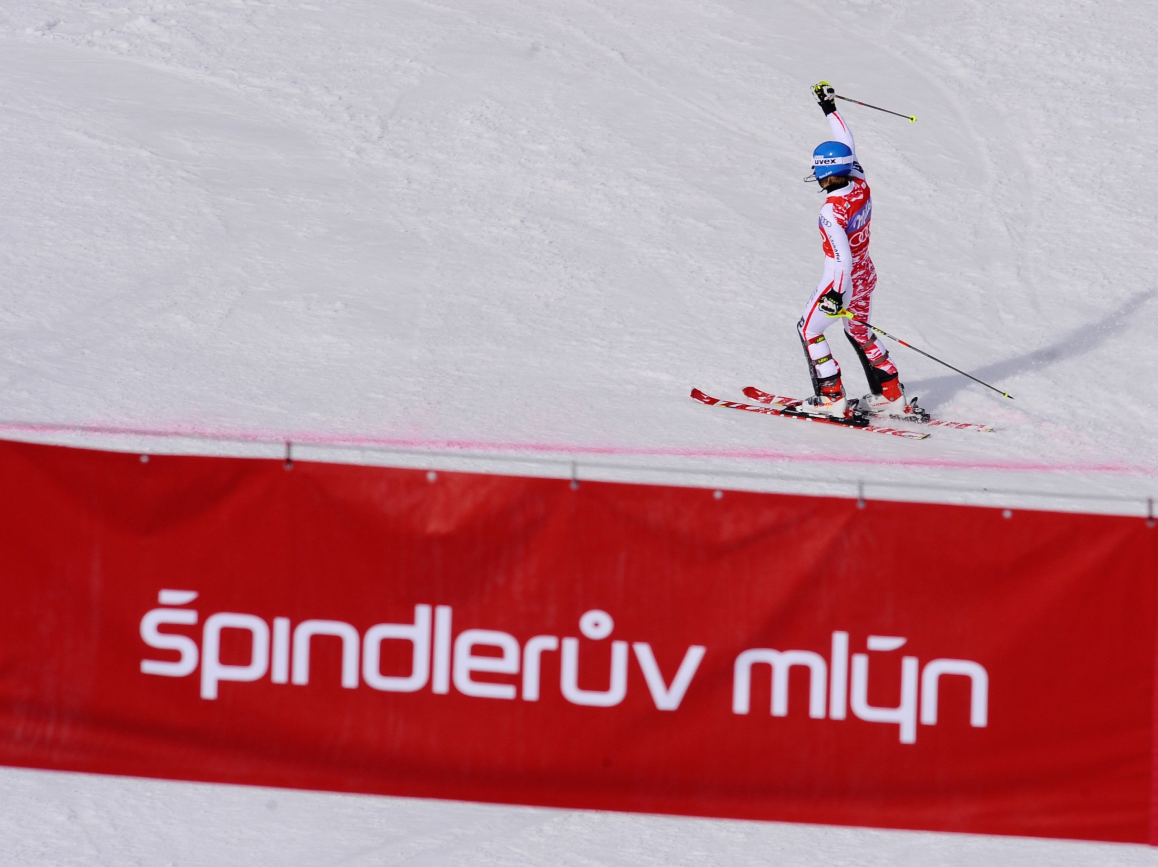




World Cup in Špindlerův Mlýn: the right choice
A well established venue for World Cup events in Europe
Interregional significance - close cooperation with Slovakia – Jasna
Modern ski area currently undergoing massive development
Improved conditions for athletes, teams, VIPs
Greater publicity and improved promotion – larger number of spectators and better atmosphere

Slide 2
Špindlerův Mlýn - a proven organizer of Alpine Ski World Cup events
Successful Ladies’ Alpine Ski World Cup events (SL, GS) in 2005, 2008, 2011
FIS WC 2005 - we were able to cope with massive amount of new snow just hours before the race
FIS WC 2008 - enormous TV audience: SL - highest viewer counts on ARD of all the ladies‘ World Cup events /3,79 mil. viewers for 20 minutes/ in total 2nd only after men‘s slalom in Kitzbuhel /ARD 4,34 mil. viewers for 12 minutes/ (official seasonal marketing and communicational analysis FIS 2008)
  FIS WC 2011- high TV viewer numbers together with excellent spectator turnout and atmosphere

Slide 3
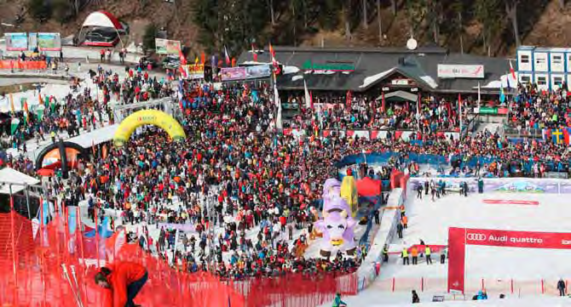
Špindlerův Mlýn - a proven organizer of Alpine Ski World Cup events

Slide 4
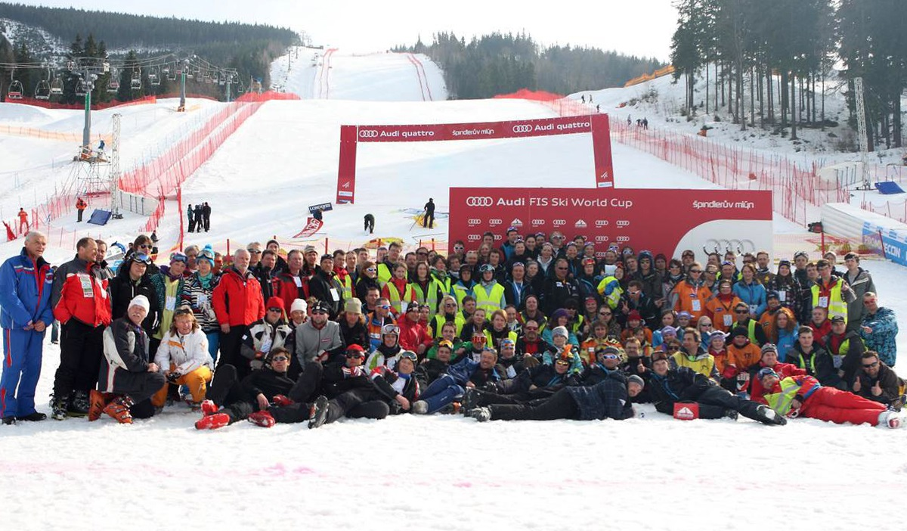
Špindlerův Mlýn – experienced team of organizers

Slide 5
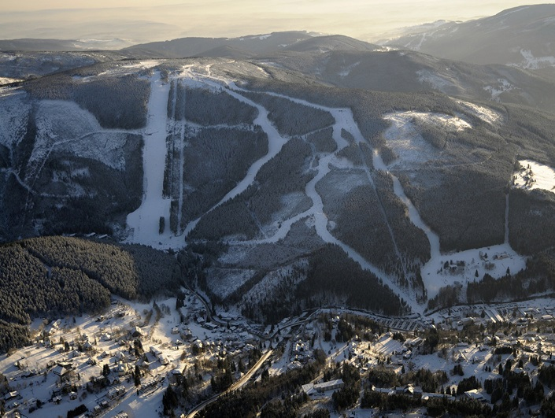

Slide 6
Interregional significance - close cooperation with Slovakia – Jasna
PROPOSED INTERCONNECTION OF EVENTS HELD IN CZ AND SVK
Taking events in turns - even years in CZ, odd years in SVK
TMR as a runner of both Spindleruv Mlyn and Jasna – the best and biggest ski areas in the CZ and SVK
Common state and ski association heritage
Common goals in tourism development of the Central European Region
Common goals on the field of sports – tradition of mutual cooperation and assistance

Slide 7
Skiareál Špindlerův Mlýn - novelties and innovation
New financially strong operator of the Skiareál Špindlerův Mlýn - Melida a.s. with TMR participation
initial investment of CZK 800,000,000 = EUR 32,000,000
15 km of new slopes
4 new cable cars and 2 ski lifts
20 new catering facilities
new snow making devices and enhanced course safety
less impact of events on normal operation of the area - more spectators along the course

Slide 8
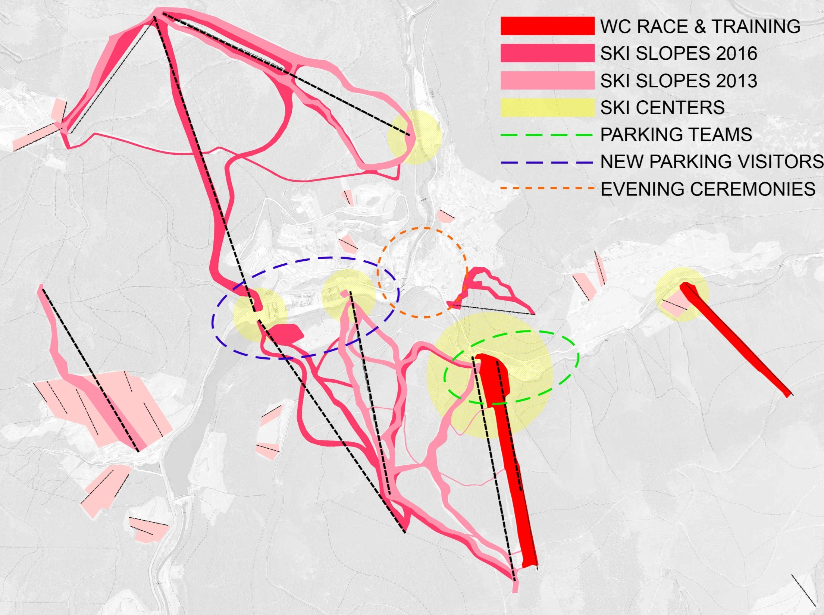

Slide 9
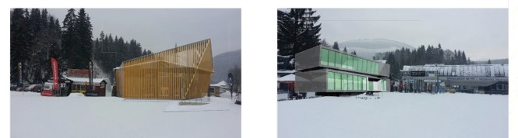
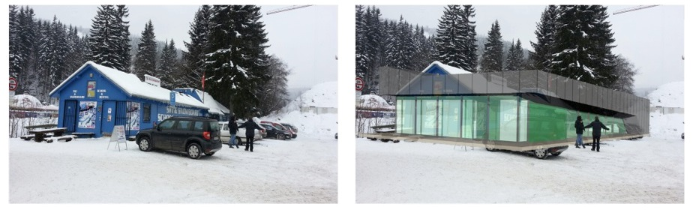
Skiareál Špindlerův Mlýn - modernization of the resort – major improvement

Slide 10
Špindlerův Mlýn - courses
Racing - Cerna (Back) “S.P. - FIS World Cup”
high quality northern slope, snow making, lighted
the parameters comply with the requirements for a World Cup course
all the SL course and three quarters of the GS course are visible from the finish area
excellent course preparation at both sub-zero and above-zero temperatures - in spite of very high temperature in March 2011 racers starting as the 30th in the second round achieved the best times (GS Rebensburg, SL Shield)
Practice - Ski Area Stoh
same parameters as the race slope
available for FIS anytime all day long
Warm-Up
GS - Cervena (Red)
SL - “S.P. - FIS World Cup” above the start

Slide 11
Špindlerův Mlýn - finish area
Compact and functional layout – easy and fast movement and orientation for all participants
TV commentators’ cabins situated directly opposite the course
VIP and Team Hospitality right in the finish area
Press Centre only 100 meters from the finish area
natural amphitheatre enhances the atmosphere for the spectators
team parking on the spot
medical centre and helicopter on site

Slide 12
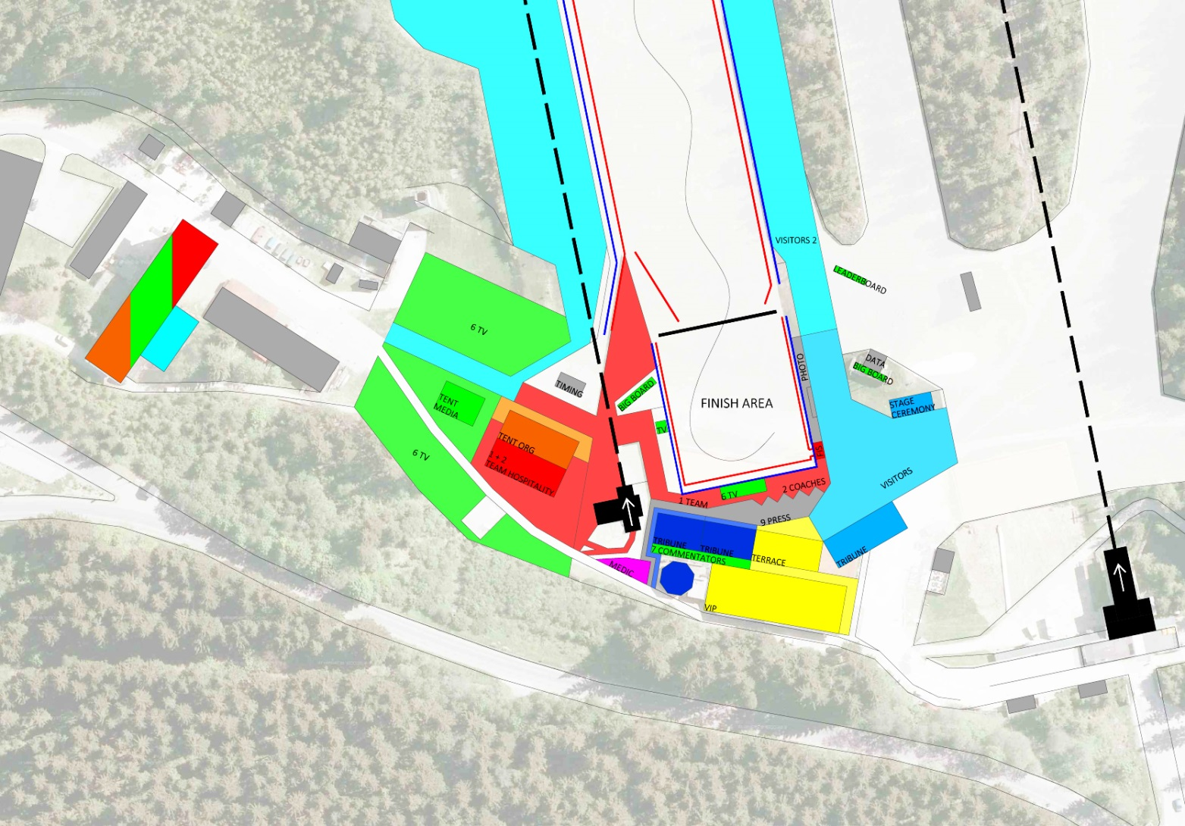
Špindlerův Mlýn – the finish area

Slide 13
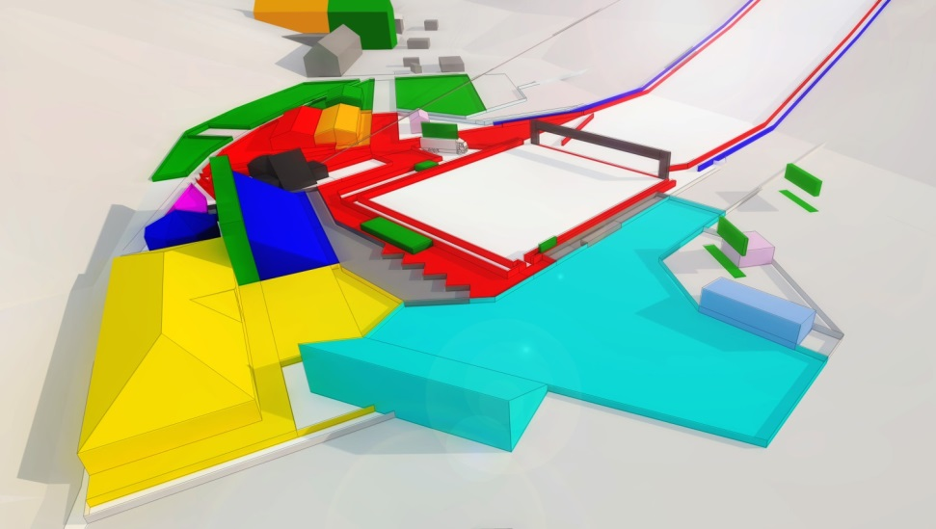

Slide 14
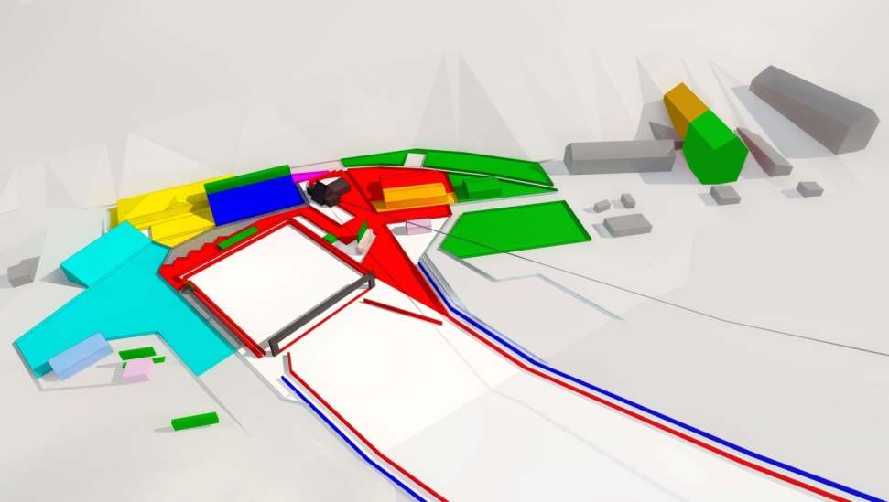

Slide 15
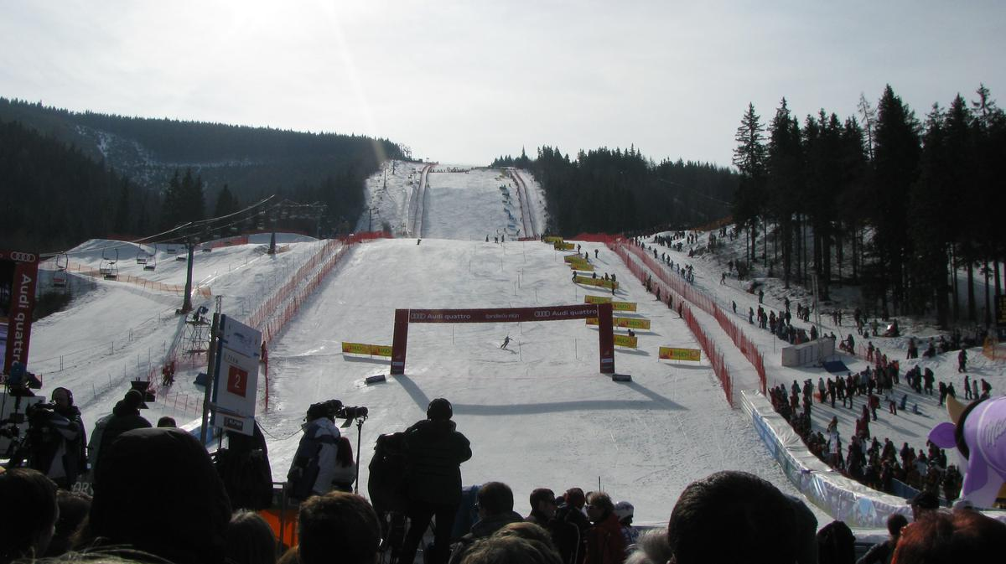
Špindlerův Mlýn –view of the course from the finish area

Slide 16
The Town of Spindleruv Mlyn Modernization
Extensive reconstruction of the Orea Hotels in the centre of Spindleruv Mlyn (Central, Spindlerovska Restaurant, the town square, relaxation and culture zone)
Enables hosting dignified draw, medal ceremonies and cultural program that accompanies the event in the very town centre
Race course and practice courses within 2 kilometres from all the participants’ accommodation
Accommodation capacity of 10,000 +

Slide 17
Improved conditions for athletes and teams
  Prize Money – SFR 100,000 + 50,000 extra
    TOP (1 - 30)
    31st after the first round
    The youngest to qualify into the second round
    The highest bib number to qualify into the second round
More practice opportunities for teams in the enlarged area
Practice Slope Stoh - same parameters as the race slope
- available for FIS anytime all day long
Race course and practice courses within 2 kms from all the participants’ accommodation

Slide 18
Enhanced FIS VIP and VIP hospitality
VIP Hospitality program is a priority for the next FIS World Cup event, in order to establish a solid foundation for long-term support and growth of alpine skiing in the Czech Republic by the relevant partners - institutions, companies and brands
Taking place in new and improved facilities
Complex program designed to entertain the participants
Interaction with the participating alpine ski legends and a lot more…

Slide 19
Involvement of Alpine skiing legends from the region
Invitation and presentation of world ski legends from the neighboring regions POL, RUS, CZE, SVK, HUN
Greater attractiveness and value particularly from the perspective of VIP Hospitality and Corporate Hospitality programs
Increased attractiveness for fans
Ensured cooperation with national TV - programs, documentaries, interviews - media publicity to promote alpine skiing

Slide 20
Greater publicity and improved promotion – larger number of spectators and better atmosphere
Spectators in the finish area and along the course
  Massive development of the ski area
    better facilities
    significant enlarging of the area
    less impact of the event on normal operation of the area - more spectators along the course
    better parking and possibility to travel on skis within the resort

Slide 21
Long term TV projects to promote Alpine Skiing and the World Cup in CZ
Two projects on CZ most prominent national TV Sport Channel CT Sport
    “S CT Sport na vrchol”
    “ALLIANZ Czech Cup”
Both projects to be used to promote the World Cup to spectators

Slide 22
“S CT Sport na vrchol” – a project to promote alpine skiing on national TV channel
Has been a successful project to promote alpine skiing for four years; cooperation of Czech Ski Association and Czech TV
Amateur racers compete to qualify to a six day training camp (for 5 men and 5 women) at various ski areas for 30 days; participation in the NC CZE
30 days of publicity, 15 minute prime time coverage on the most prominent sports channel in CZ + two repeats and further news coverage on national TV
Connection between hobby and top professional skiing; ski legends participation
The unique project to be used as a mean of massive activation of fans and promotion of Ladies’ World Cup in CZ – the final race on the day before the event

Slide 23
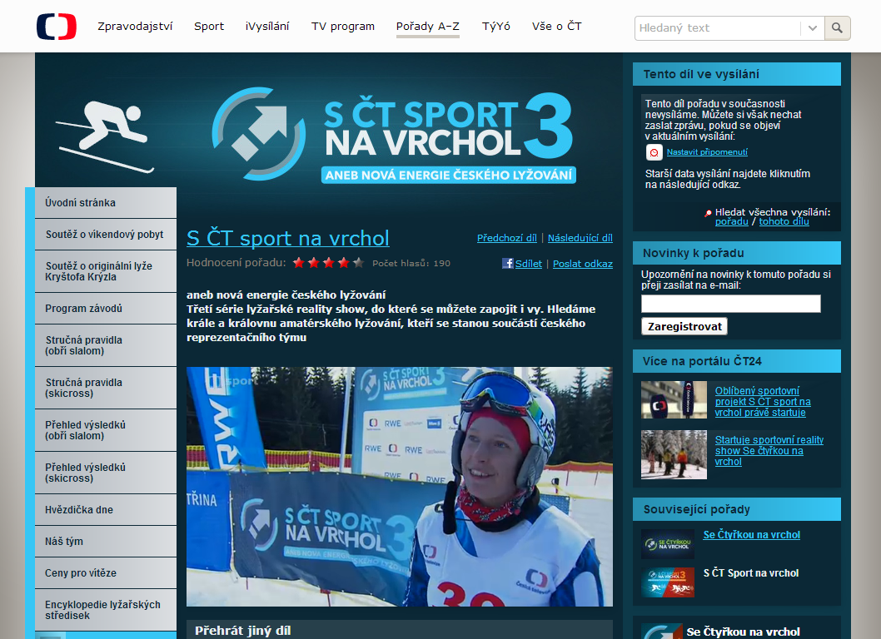
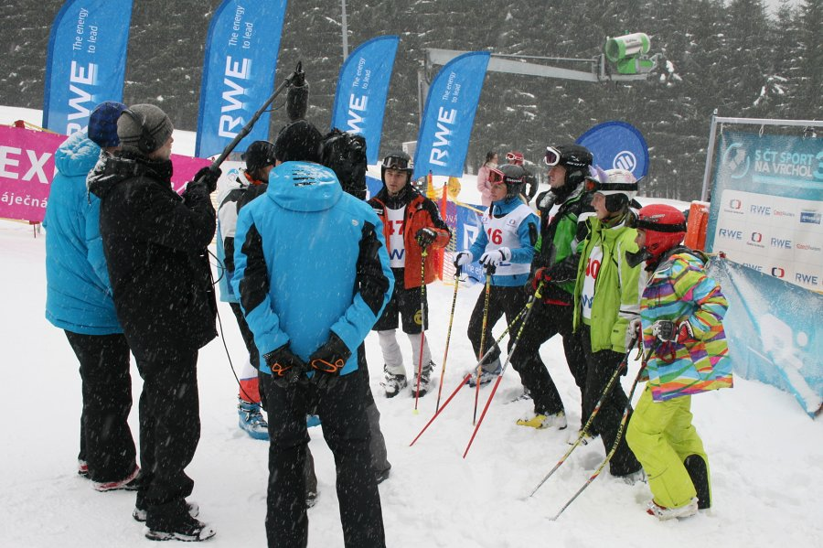
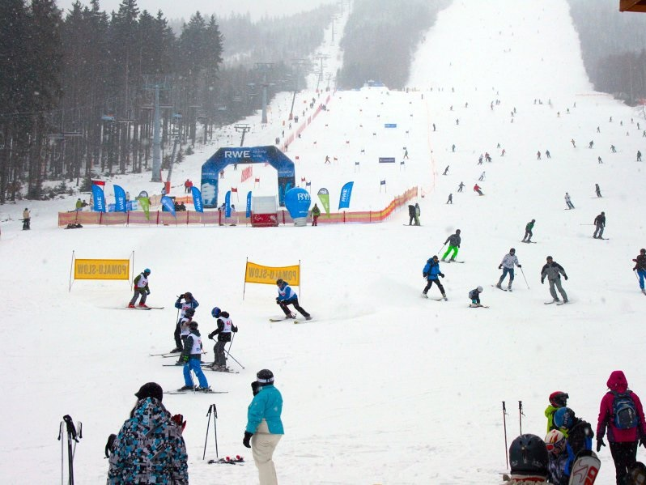
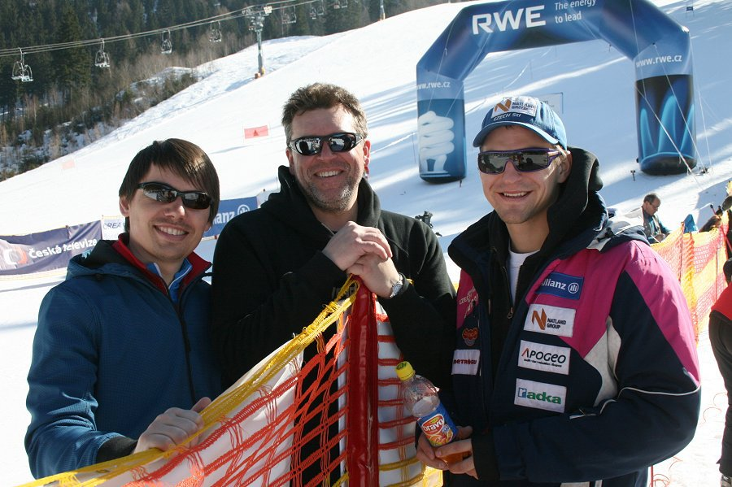

Slide 24
Promotion of alpine skiing on national TV: „ TV project ALLIANZ Czech Cup“
TV broadcasts of FIS international events and National Championships held in the Czech Republic on the most prominent sports channel in CZ
  30 minute TV broadcasts of 5 FIS events and Czech NC (MMCR)
  Three repeats of each of them
  At present 600 minutes of TV time for alpine disciplines

Slide 25
Activation of fans and publicity for CZ - Slovakia – Poland – Saxony regions
To support the publicity of the races we will activate the fans and we will arrange for publicity for the Czech, Slovakia, Southern Poland, and Saxony regions
Media coverage for the neighbouring regions outside the Czech Republic
Planned media campaigns and PR coverage even outside the Czech Republic – in Southern Poland, Saxony, and Slovakia (Eurosport, billboards)
Špindlerův Mlýn as the best ski resort in the Czech Republic is attractive for skiers and fans from Poland and Saxony. Natural partnership occurs with Slovakia.

Slide 26
Involvement of secondary schools in the Hradec Kralove Region
The Regional Program to promote skiing “Fandime lyzovani” targets the group of 16 - 20 years of age.
Long term project concerning the Alpine ski World Cup at schools – projects on particular athletes, event venues, etc.
Establishing the athletes fan clubs at schools around the region to improve the event atmosphere and enhance the athlete - fan interaction
Bringing the schoolchildren to the event to improve the atmosphere
  In 2011 75 busses brought 3000 high school students to watch the WC event - a successful project of fan activation to be repeated

Slide 27
Regional and state Authorities’ Support
Hradec Kralove Region Government support
  Support for Secondary School project
  Providing transportation for the students
Support from the government of the Czech Republic
  State financial support
  Patronage of the government officials
  Direct participation of the government officials - enhancing the prestige of the event
  A government program to enhance tourism in the CZ targets skiing as one of the means to achieve the goal

Slide 28

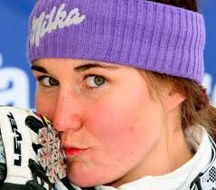
Alpine Skiing – part of national government program CzechTourism to enhance tourism in CZ
Sarka Zahrobska chosen as a representative of sport for „LETS CREATE STORIES ABOUT CZECH REPUBLIC“ program

Slide 29
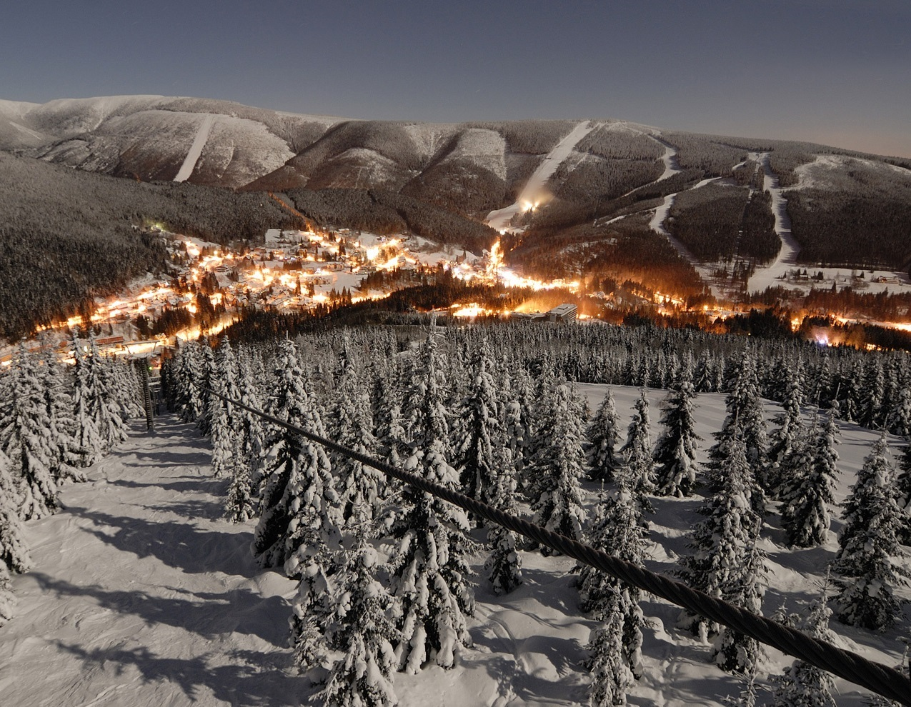


Špindlerův Mlýn – the right choice.
Thank you for your attention.

